Slide 1
CHAPTER 6
STRATEGIC MANAGEMENT
How Exceptional Managers Realize a Grand Design

Slide 2

Strategic Positioning and Levels of Strategy
Strategic Positioning attempts to achieve sustainable competitive advantage by preserving what is distinctive about a company.
Strategy is the creation of a unique and valuable position.
Three levels of strategy
Corporate-Level Strategy
Business-Level Strategy
Functional-Level Strategy

Slide 3
THREE Levels of Strategy

Slide 4
THE STRATEGIC-MANAGEMENT PROCESS

Slide 5
SWOT analysis is a good first step at gaining insight into whether or not a company has competitive advantage.

Slide 6
Using VRIO to Assess Competitive Potential: Value, Rarity, Imitability, and Organization
VRIO (pronounced by its letters, “V-R-I-O”) is a framework for analyzing a resource or capability to determine its competitive strategic potential
Answer four questions about its Value, Rarity, Imitability, and Organization
Is the resource or capability . . .

Slide 7
Benchmarking: Comparing with the Best
FIGURE: Airline benchmarks

Slide 8
Three Overall Types of Corporate Strategy
Growth strategy:
Involves expansion, as in: sales revenues, market share, number of employees, or number of customers.
Stability:
Involves little or no significant change.
Defensive:
Involves reduction in the organization’s efforts.

Slide 9
THE BCG MATRIX (Boston Consulting Group)

Slide 10

Establishing Business-Level Strategy
Porter’s Five Competitive Forces
Porter’s Four Competitive Strategies

Slide 11
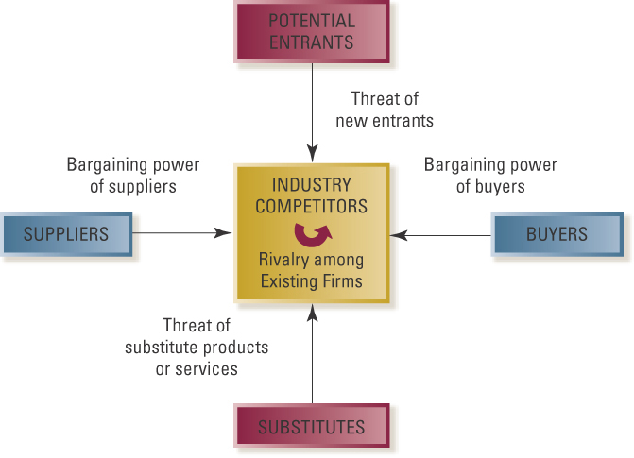
Porter’s 5 Forces: Model of Industry Competition

Slide 12
Porter’s 5 Forces: Model of Industry Competition
(1) Threat of
new entrants
(3) Bargaining power of suppliers
(2) Bargaining power of buyers
(5)
(4) Threat of
substitute products and services

Slide 13
Porter’s Four Competitive Business-level Strategies
Cost-Leadership Strategy: Keeping costs and prices low for a wide market
Differentiation Strategy: Offering unique and superior value for a wide market
Cost-Focus Strategy: Keeping costs and prices low for a narrow market
Focused-Differentiation Strategy: Offering unique and superior value for a narrow market

